Slide 1

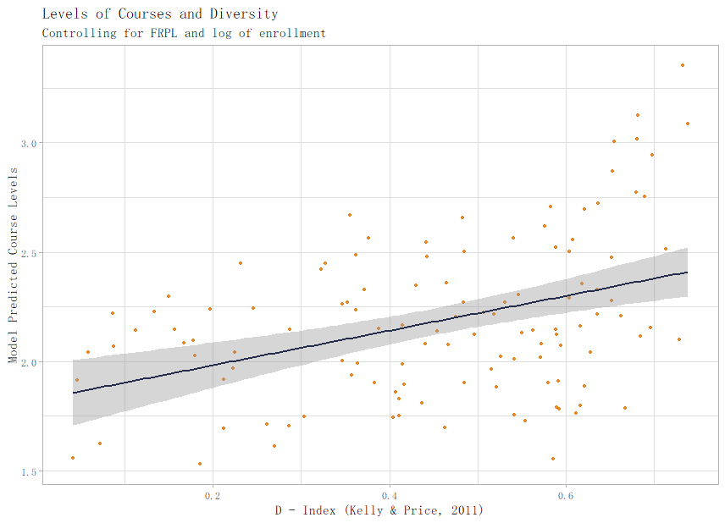
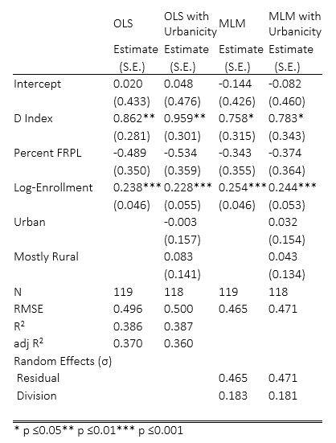
Leveling Up: State- and Division-Level Barriers to Advanced Studies in Virginia Rose Sebastian, Margaret E. Thornton, Andrew McCartney
INTRODUCTION
Despite the compelling public policy rhetoric concerning providing equitable access to a rigorous education for all students, there exists a paucity of research into division-level policies sorting students into tracks. In a study of such policies in North Carolina, Kelly (2007) notes “Research on tracking will continue to be disconnected from school improvement efforts until the relationships between school policies, the organizational dimensions of tracking, and outcomes for students are understood.” Tracking occurs in almost all subject areas but departments vary in their level of tracking (Kelly & Price, 2011). Kelly (2007) examined 1997 curriculum guides from 92 high schools in North Carolina and discovered that the selectivity of tracks varied across departments. He found English was the most tracked department while social studies was the least tracked subject. Kelly and Price (2011) then examined the 2007 curriculum guides from 128 schools in North Carolina, including 91 of the original 92 schools, to understand how tracking changed over time. Overall the selectivity of tracking systems had remained stable, but English had become less selective and social studies had become more selective. Kelly (2007) and Kelly and Price’s (2011) studies remain the only two to examine the extent of tracking within states. No such research has been done on other states.
METHODS
We combined qualitative and qualitative analyses of district programs of study with state level policies, and state level data on student demographics and outcomes to better understand tracking within the state. We gathered district data on the numbers and demographics of students graduating with Virginia’s two types of diplomas as well as on the number of students dropping out of school. Virginia also encourages schools to offer specialty program for advanced students including Governor’s schools and programs for academically struggling students. We gathered data on these programs and their enrollment. We also gathered programs of study from 119 of the 131 (91%) districts in the Commonwealth of Virginia.
We coded the programs of study by the number of levels of state tested courses, the levels of those courses, the number of prerequisites for each course, and the type of prerequisites. We also counted the total number of math and science courses offered, the number of Advanced Placement courses, and the numbers and types of virtual and Dual Enrollment courses offered. Finally, we qualitatively coded the narrative text of the prerequisites and statements in the program of study about course levels, choosing courses, and changing courses. We also gathered state level data on district enrollment, graduation numbers, demographics, dropout rates, and enrollment in specialty programs such as Governors’ schools. To ensure reliability, the first two authors double coded 20% of the programs of study.
RESULTS
In addition to looking at variations in levels between schools, we also looked at variations between departments, finding that English departments had the highest number of levels and social studies the fewest.
While many school districts begin their program of study with an encouraging message to students, over 20% of districts in the state set restrictive entry requirements to all honors and advanced levels courses.
Overall, access to honors and Advanced Placement courses is limited. In English 12, for example, 98% of districts across the state have no requirements for entry into the standard course but 24% of districts have one prerequisite for entry to the honors course, and 40% have two or more prerequisites for entering an honors course. While schools vary in what prerequisites they set, GPA and teacher recommendations are two of the most common. For English 10 Honors, 48 of 77 districts used a GPA cut off and 44 of 77 required teacher recommendations. Other requirements included summer work, applications to the course, and personal characteristics.
RESULTS
Developed Metric with 13 content area courses as the ratio of courses offered to SOL courses generally.
Mean of 2.18 levels and SD of 0.63
Least leveled: Northumberland & Dinwiddie | Most leveled: Fairfax (4.69 levels per course on average)
Regress leveledness on urbanicity, percent FRPL, diversity index of district, and natural log of enrollment.
OLS and MLM (with 8 division regions as clusters; ICC was 0.16)
Urbanicity never significant, nor was percent FRPL
Diversity was significant at p < 0.01 for OLS and p < 0.05 for MLMs
Difference between a totally homogeneous district and a maximally heterogeneous district was approximately 0.8 additional levels per course, on average
RESEARCH PURPOSE:
This study builds on and expands Kelly and Price’s (2011) work by studying district level programs of study from 118 of Virginia’s 131 school district and comparing those data with state-level tracking policies and student outcomes data. The purpose of this study was to examine the state-level policies that shape tracking in Virginia, to learn the contours of tracking in Virginia school districts, and to relate those policies to student outcomes and demographics.
RECOMMENDATIONS FOR FUTURE RESEARCH
What informal prerequisites (Modica, 2015; Yonezawa, Wells, & Serna, 2002) may exist that were not captured in this study?
How are students with disabilities treated in school tracking programs?
What are the racial and socioeconomic makeup of the courses offered in each division? How might race and SES interact?

